Slide 1
On the Utility of Curricula in
Unsupervised Learning of Probabilistic Grammars
Kewei Tu and Vasant Honavar
Artificial Intelligence Research Laboratory
Department of Computer Science
Iowa State University

Slide 2
Outline
Unsupervised Grammar Learning
Grammar Learning with a Curriculum
The Incremental Construction Hypothesis
  Theoretical Analysis
  Empirical Support

Slide 3
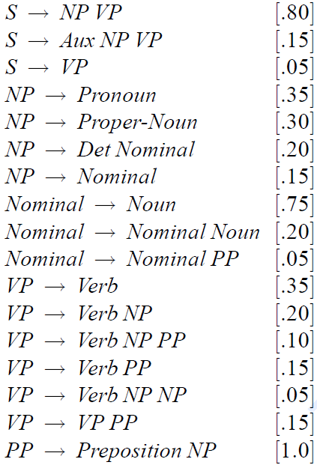
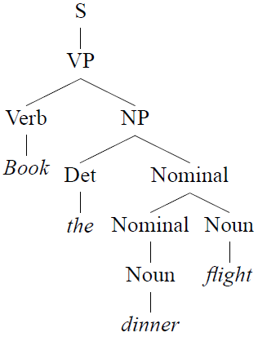
Probabilistic Grammars
A probabilistic grammar is a set of probabilistic production rules that define a joint probability of a grammatical structure and its sentence
P = 2.2 × 10⁻⁶
……
Example from [Jurafsky & Martin, 2006]

Slide 4
Probabilistic Grammars
Probabilistic grammars are widely used in
  Natural language parsing
  Bioinformatics, e.g., RNA structure modeling
  Pattern recognition
Specifying grammars is hard
  Machine learning offers a practical alternative
Notes:
Mention: in many applications, no grammar ready for use, hence machine learning

Slide 5

Learning a grammar from a corpus
Supervised Methods
  Rely on a training corpus of sentences annotated with grammatical structures (parses)
Unsupervised Methods
  Do not require annotated data
Training Corpus
Probabilistic Grammar
Induction
A square is above the triangle.
A triangle rolls.
The square rolls.
A triangle is above the square.
A circle touches a square.
……
S → NP VP
NP → Det N
VP → Vt NP (0.3)
| Vi PP (0.2)
| rolls (0.2)
| bounces(0.1)
……

Slide 6


Current Approaches
Process the entire corpus to learn the grammar
No, it wasn't Black Monday. But while the New York Stock Exchange didn't fall apart Friday as the Dow Jones Industrial Average plunged 190.58 points -- most of it in the final hour -- it barely managed to stay this side of chaos. Some “circuit breakers”' installed after the October 1987 crash failed their first test, traders say, unable to cool the selling panic…
Image from www.editorsweblog.org
Image from www.christart.com

Slide 7

Grammar Learning with a Curriculum
Good.
Come here.
……
The rabbit is behind the tree.
Alice is sitting on the riverbank.
……
Alice: I wonder if I've been changed in the night? Let me think. Was I the same when I got up this morning? I almost think I can remember feeling a little different…
Image from www.ibirthdayclipart.com
Start with the simplest sentences
Progress to increasingly more complex sentences

Slide 8
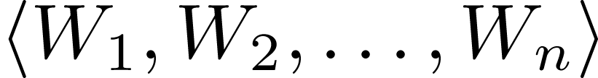


Curriculum Learning [Bengio et al., 2009]
A curriculum is a sequence of weighting schemes of the training data:
  assigns more weight to “easier” training samples
  Each subsequent weighting scheme assigns more weight to “harder” samples
  assigns uniform weight to each sample
Learning is iterative
  In each iteration, the learner is
    initialized with the model learned during the previous iteration
    trained from the data weighted by the current weighting scheme

Slide 9
Experiments
Learning a probabilistic dependency grammar from the Wall Street Journal corpus of the Penn Treebank
  Base learning algorithm
    Expectation-maximization
  Sentence complexity measure
    Sentence length
    Sentence likelihood given the learned grammar
  Weight Assignment
    0 or 1
    A continuous function

Slide 10
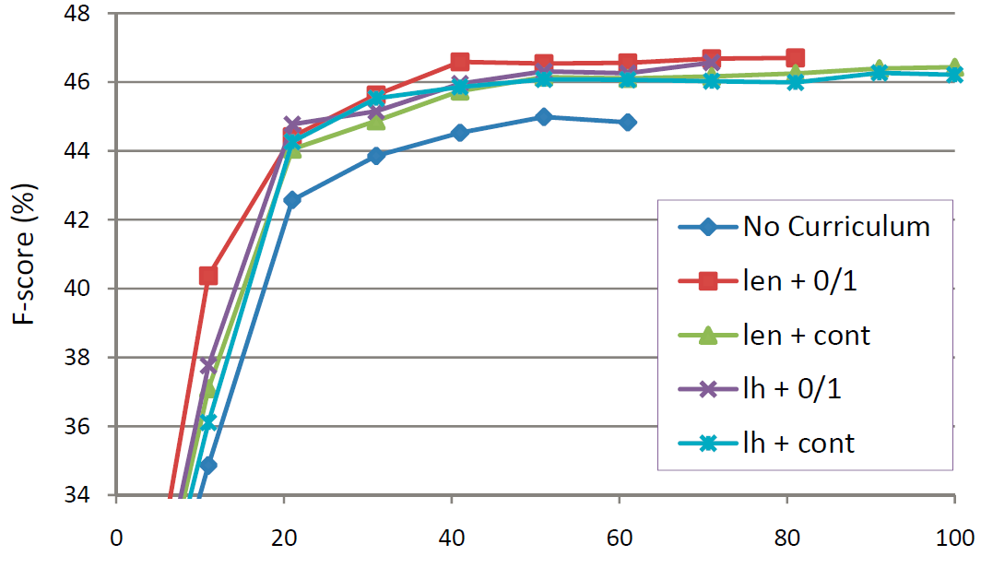
Experimental Results
All of the four curricula help learning.

Slide 11
Questions
Under what conditions does a curriculum help in unsupervised learning of probabilistic grammars?
How can we design good curricula?
How can we design algorithms that can take advantage of the curricula?

Slide 12




The Incremental Construction Hypothesis
An ideal curriculum gradually emphasizes data samples that help the learner to successively discover new substructures (i.e., grammar rules) of the target grammar, which facilitates the learning.
We say a curriculum satisfies incremental construction if:
  For any , the weighted training data correspond to a sentence distribution defined by a probabilistic grammar
  For any , is a sub-grammar of
  (See Section 3 of the paper for the more precise definitions)
Notes:
Mention: no need to be a precise sub-grammar

Slide 13


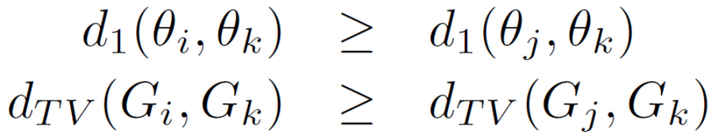



Theoretical Analysis
Theorem: If a curriculum satisfies incremental construction, then for any s.t. , we have
where is the distance between the grammar rule probabilities; is the total variation distance between the distributions of grammatical structures defined by the two grammars.

Slide 14
Intermediate grammars
With a curriculum
G₀
G_{n}
Without a curriculum

Slide 15
Guidelines for Curriculum Design
A good curriculum should:
  (approximately) satisfy incremental construction
  effectively break down the target grammar into as many chunks as possible
  at each stage, introduce the new rule(s) that results in the largest number of new sentences
    if r₁ is required for r₂ to be used, then r₁ shall be introduced earlier than r₂
    among rules with the same LFS, rules with larger probabilities shall be introduced first

Slide 16
Guideline for Algorithm Design
Observation
  the learning target at each stage of a curriculum is a partial grammar
Guideline
  avoid the over-fitting to this partial grammar that hinders the acquisition of new grammar rules in later stages

Slide 17
Experiments on Synthetic Data
Data generated from the Treebank grammar of WSJ30
Curricula constructed based on the target grammar
  Ideal: Satisfies all the guidelines
  Sub-Ideal: Doesn’t satisfy the 3rd guideline: randomly choosing new grammar rules at each stage
  Random: Doesn’t satisfy any guideline: randomly choosing new sentences at each stage
  Ideal-10, Sub-Ideal-10, Random-10: Introduce at least 10 new sentences at each stage, hence containing fewer stages
  Length-based: Introduces new sentences based on their lengths

Slide 18
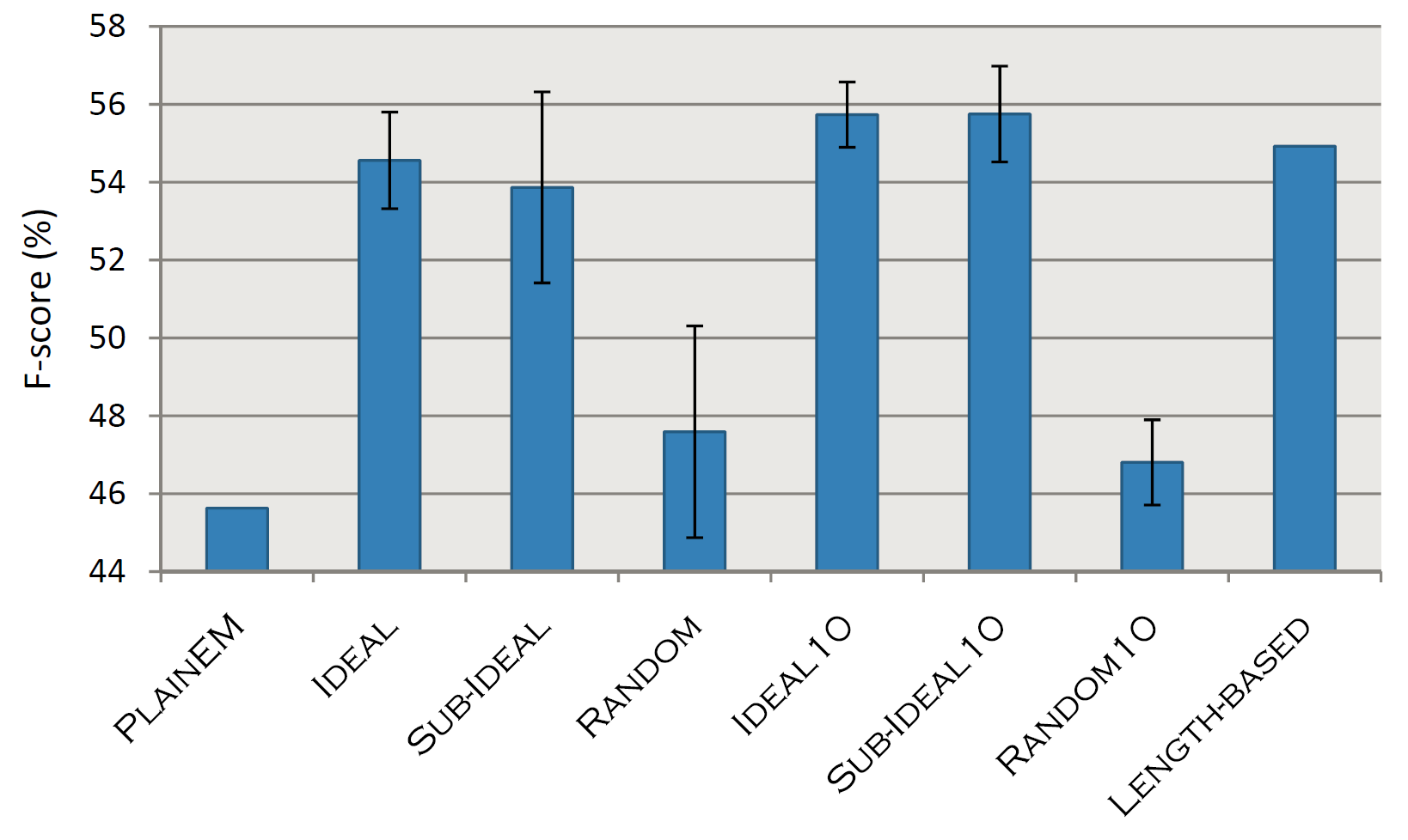
Experiments on Synthetic Data

Slide 19
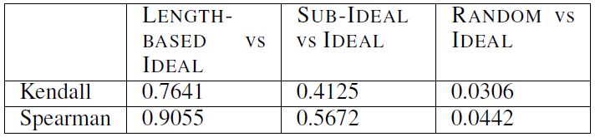
Length-based Curriculum
Very similar to the ideal curricula in this case (measured by rank correlation)

Slide 20
Analysis on Real Data
Ideal curricula cannot be constructed in unsupervised learning from real data
We find evidence that the length-based curriculum can be seen as a proxy for an ideal curriculum on real data

Slide 21
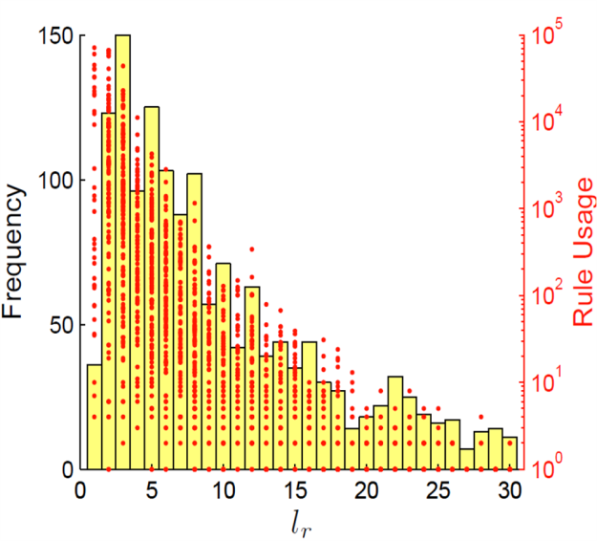
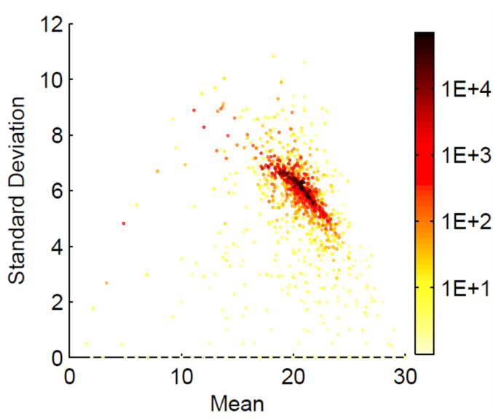
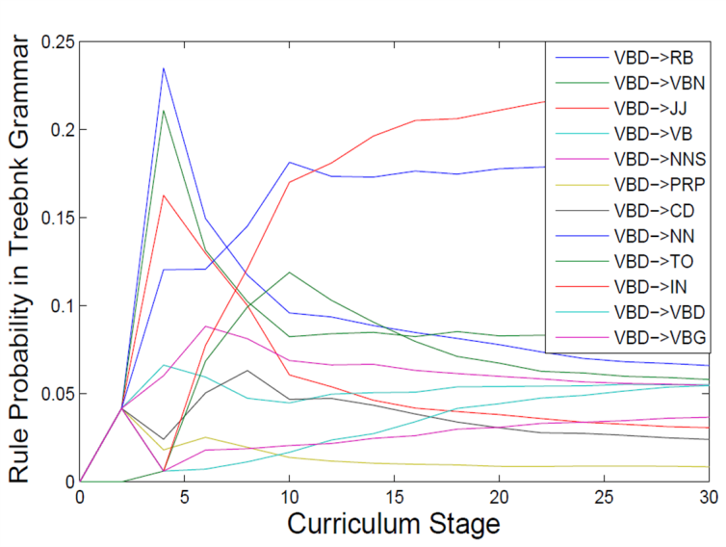
Evidence from WSJ30
The introduction of grammar rules is spread throughout the entire curriculum
More frequently used rules are introduced earlier

Slide 22
Evidence from WSJ30
Grammar rules introduced in earlier stages are always used in sentences introduced in later stages

Slide 23
Evidence from WSJ30
In the sequence of intermediate grammars, most rule probabilities first increase and then decrease, which satisfies a relaxed definition of ideal curricula that satisfy incremental construction

Slide 24
Conclusion
We have introduced the incremental construction hypothesis
  an explanation of the benefits of curricula in unsupervised learning of probabilistic grammars.
  a source of guidelines for designing curricula as well as unsupervised grammar learning algorithms
The hypothesis is supported by both theoretical analysis and experimental results (on both synthetic and real data)

Slide 25
Thank You!
Q&A

Slide 26
Backup

Slide 27
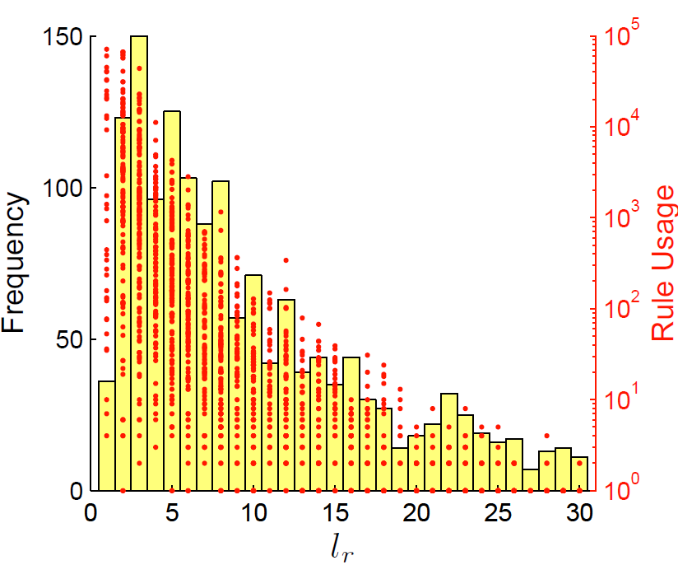
l_{r} : the length of the shortest sentence in the set of sentences that use rule r

Slide 28
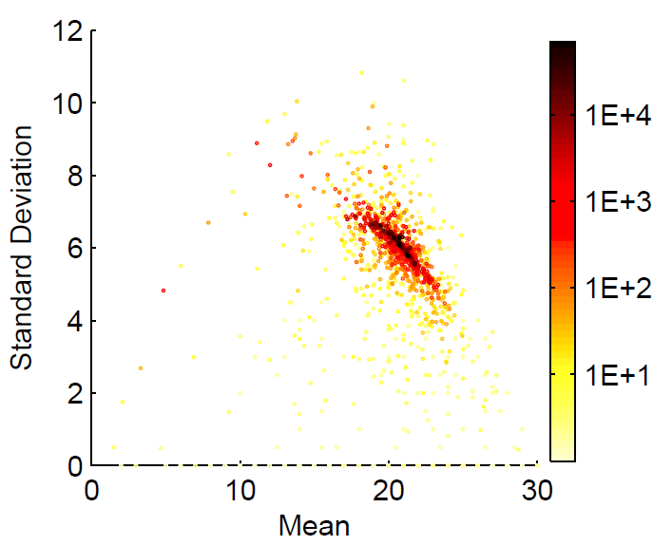
Mean and std of the lengths of the sentences that use each rule

Slide 29
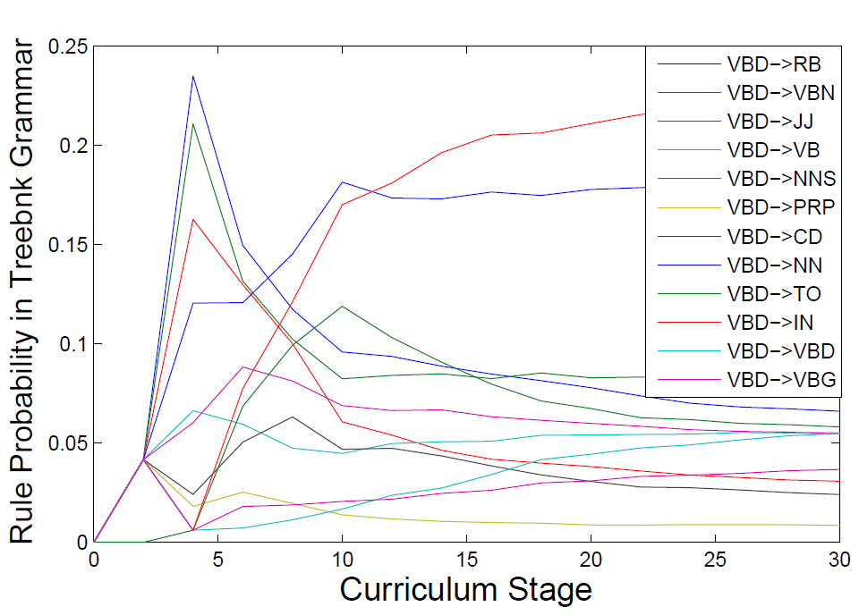
The change of probabilities of VBD headed rules with the stages of the length-based curriculum in the treebank grammar.

