Slide 1


The increasing cost tree search for optimal multi-agent pathfinding
Guni Sharon, Roni Stern, Meir Goldenberg, Ariel Felner.
Ben-Gurion University of The Negev
Department of Information Systems Engineering
Israel

Slide 2
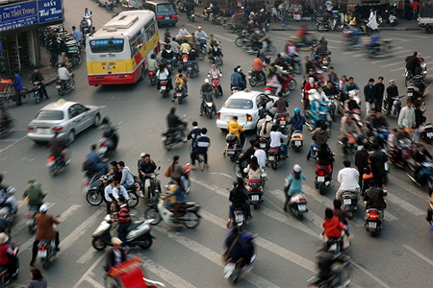
Background
Background
Previous work
ICTS formalization
Theoretical analysis
Do it faster
Summery
In Multi-Agent Path Finding we would like to find
A path for each agent, such that
  The different paths won’t overlap
  Task: Minimize the total travel cost

Slide 3
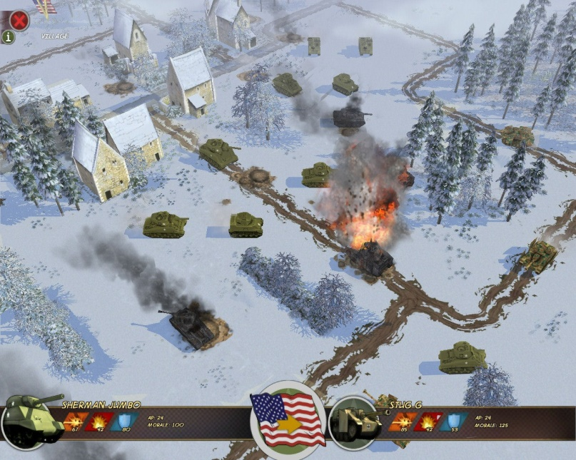
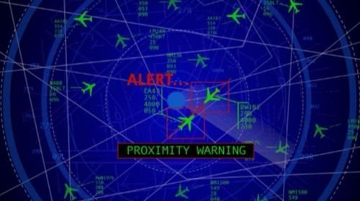
Motivation
Background
Previous work
ICTS formalization
Theoretical analysis
Do it faster
Summery
Robotics
Video games
Vehicle routing
Air/Train traffic control

Slide 4
Previous work
Background
Previous work
ICTS formalization
Theoretical analysis
Do it faster
Summery
  Decoupled approach: Every agent plans separately.
    + Fast
    - Non optimal
    - Many times not complete
  ([Dresner and Stone, 2008], [Jansen and Sturtevant, 2008], [Silver, 2005], [Wang and Botea, 2008])
  Centralized approach: agents are planned together
    + Can be optimal
    + Complete
    - Exponentially hard
    ([Ryan, 2008], [Ryan, 2010], [Standley, 2010], [Wang and Botea, 2008])

Slide 5
A* search
Background
Previous work
ICTS formalization
Theoretical analysis
Do it faster
Summery
  Previous work used A* to solve this problem
  [Standley, 2010]
The heuristic used to guide the A* search is the Sum of Individual Costs (SIC).
SIC is the sum of shortest paths of each agent assuming that no other agent exist.
For the 15 puzzle, assuming each tile is an agent, this is Manhattan Distance.

Slide 6
A* search
Background
Previous work
ICTS formalization
Theoretical analysis
Do it faster
Summery
  State – a set of locations, one per agent.
5 possible
moves
Stay!
5 possible
moves
Stay!
Expanding this state results in 25 new states!

Slide 7

Search Tree Growth
Background
Previous work
ICTS formalization
Theoretical analysis
Do it faster
Summery
a | b | c
d | e | f
g | h | i
Root
a,i
. . .
d,f
d,h
d,i
b,f
. . .
g,i
g,c
g,e
a,f
a,i
a,c

Slide 8
Problem!
Background
Previous work
ICTS formalization
Theoretical analysis
Do it faster
Summery
The branching factor is (k is the number of agents)
On a problem with only 20 agents:
  Branching factor = 95,367,431,640,625
  A* can’t expand even the root!!!
Even given a perfect heuristic – A* is not feasible!

Slide 9

State-of-the-art A* approach
Background
Previous work
ICTS formalization
Theoretical analysis
Do it faster
Summery
Recently, two major enhancements to the A* approach were presented [Standley, 2010]
  Operator Decomposition (OD)
  Independence Detection (ID) – relevant in our case too.
Independent sub-problem
Independent sub-problem
problem

Slide 10
Our new algorithm
The increasing cost tree search (ICTS)

Slide 11
ICTS: Observation
Background
Previous work
ICTS formalization
Theoretical analysis
Do it faster
Summery
A solution for MAPF is composed of single agent solutions (one per agent).
we decompose the total solution cost to cost per agent
15
5
3
7
Solution’s cost

Slide 12
The increasing cost search
Background
Previous work
ICTS formalization
Theoretical analysis
Do it faster
Summery
The Increasing Cost tree Search (ICTS) is conceptually different from A*. It consist of two levels.
The high level:
  What is the cost for every agent?
The low level:
  Is there a valid solution based on a vector of costs (Given by the high level)?
c1
c2
c33

Slide 13


The increasing cost approach
Background
Previous work
ICTS formalization
Theoretical analysis
Do it faster
Summery
Is there a solution with costs
?
High-level
What about this?
3
3
3
3
4
3
NO!
YES!
Low-level
3
3
4
3

Slide 14
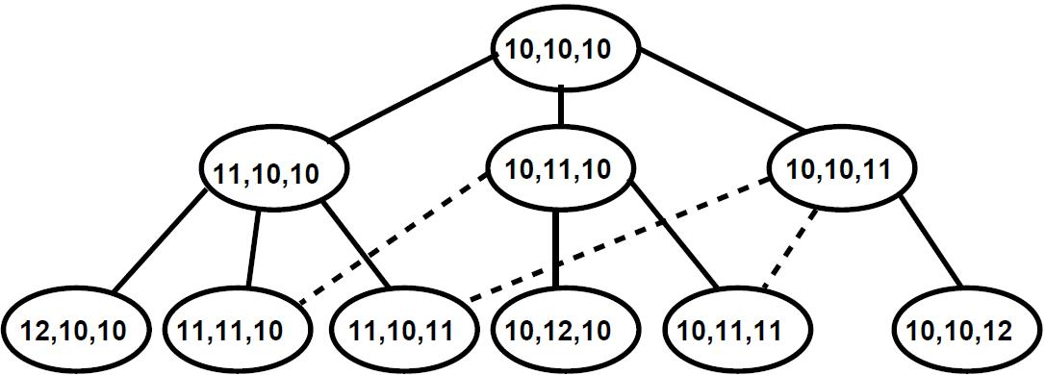
High Level
Background
Previous work
ICTS formalization
Theoretical analysis
Do it faster
Summery
The high level searches the Increasing Cost Tree (ICT) - defined as follow:
  Node – a cost vector (cost per agent)
  Operators – one agent’s cost is increased by one.
  Root – The minimal individual costs (SIC).

Slide 15

High level search
Background
Previous work
ICTS formalization
Theoretical analysis
Do it faster
Summery
Search the ICT in a breadth-first manner.
For each node: is there a solution restricted to the given costs set?
The first solution found is surely optimal.
Find a solution
No solution
∆
Tree size=O( )

Slide 16
Low-level: Goal test
Background
Previous work
ICTS formalization
Theoretical analysis
Do it faster
Summery
The low level performs a goal test - Is there a valid solution for a given ICT node?
ICT node represents all paths for all agents given the costs.
Low level:
1) For each agent enumerate all paths of its given cost.
2) Search for a valid set of paths.
c1
c2
c33

Slide 17


Enumerating paths for an agent
Background
Previous work
ICTS formalization
Theoretical analysis
Do it faster
Summery
Problem: the number of different paths for a single agent is itself exponential.
start
 |  | goal

Slide 18
Solution - Multi value decision diagram
Background
Previous work
ICTS formalization
Theoretical analysis
Do it faster
Summery
Each level represents a step
Each level has no more then |v| nodes
Compact representation for all possible paths
4-steps MDD
Start
Start | A | B
C | D | E
F | G | goal
C
A
F
D
B
G
E
Goal
Exponential in the
number of steps
Linear in the
number of steps

Slide 19
Observation - Merging MDDs
Background
Previous work
ICTS formalization
Theoretical analysis
Do it faster
Summery
Two single-agent MDDs can be merged into a two-agent MDD.
Representing all possible locations for two agents.
MDD1
MDD2
MDD(1,2)
Start1
Start2
Start1,2
Conflict!
A
B
A
C
A,A
A,C
B,A
B,C
Goal1
Goal2
Goal1,2

Slide 20
Low level formalization
Background
Previous work
ICTS formalization
Theoretical analysis
Do it faster
Summery
The low level (goal test) works as follow:
For each agent, build an MDD according the given cost.
Merge all single agent MDDs to one k-agents-MDD.
Search the k-agents-MDD search space for a solution.
MDD1
MDD2
MDD(1,2)
Start1
Start2
Start1,2
A
B
A
C
A,C
B,A
B,C
Goal1
Goal2
Goal1,2

Slide 21
Theoretical analysis
Background
Previous work
ICTS formalization
Theoretical analysis
Do it faster
Summery
A* expands the minimal nodes necessary
A* generates many unnecessary nodes (that will never be expanded)
Amount of unnecessary nodes generated is huge!
A*
Generated
S
G

Slide 22



ICTS Vs A*
Background
Previous work
ICTS formalization
Theoretical analysis
Do it faster
Summery
Assume A* expands nodes
➔ A* will generate ( ) nodes
➔ The runtime for A* is O( )
ICTS runtime is composed of
  Expanding all the ICT nodes with cost <= optimal cost (O( ))
  Performing a goal test on each of these nodes (O( ) )
➔The total runtime of ICTS is O( )
The question is what is bigger or ?
∆

Slide 23
A* Vs. ICTS tradeoff
Background
Previous work
ICTS formalization
Theoretical analysis
Do it faster
Summery
3X3 grid ,no obstacles
50 random start and goal positions
k | k' | ∆ |  |  | A*+OD+ID | ICTS
3 | 1.4 | 0.4 | 10 | 1 | 0 | 0
4 | 2.5 | 0.9 | 54 | 2 | 5 | 2
5 | 3.2 | 1.4 | 167 | 5 | 7 | 5
6 | 4.7 | 2.8 | 1,867 | 80 | 59 | 49
7 | 6.4 | 5.8 | 28,221 | 49,260 | 3,092 | 6,625
8 | 7.6 | 8.9 | 205,197 | 71,921,253 | 4,679 | 68,859
>
>
<
<

Slide 24
Speeding up ICTS
Background
Previous work
ICTS formalization
Theoretical analysis
Do it faster
Summery
Only the last ICT node is a goal
Verifying that an ICT node is not a goal is hard
identifying a non goal node faster -> significant speedup.
5
3
7
No Solution!
There is no solution
for the entire problem!
Check pair

Slide 25
Pair wise pruning
Background
Previous work
ICTS formalization
Theoretical analysis
Do it faster
Summery
  For every pair of agents (a1,a2)
  If no solution exists for a1,a2
  Halt
  Else //A solution exists
  remove all MDD nodes that can not be part of a solution
MDD1
MDD2
MDD2’
Start
Start
Start
Sparser MDDs will result in a smaller search space further on (in the low level).
A
A
B
B
Goal
Goal
Goal

Slide 26
experiments
8X8 grid , No obstacles
50 random start and goal positions
k | k' | A*+OD+ID | ICTS | ICTS+P
2 | 1.0 | 0.5 | 0.1 | 0.2
4 | 1.1 | 0.7 | 0.2 | 0.4
6 | 1.5 | 2.9 | 0.4 | 0.4
8 | 2.7 | 108.0 | 2.7 | 3.3
10 | 3.5 | 23,560.4 | 542.1 | 14.0
12 | 5.2 | 50,371.4 | 2,594.6 | 69.8
14 | 7.1 | 300,000.0< | 20,203.1 | 707.7
16 | 9.6 | 300,000.0< | 29,634.2 | 833.7
X43
X1,683

Slide 27
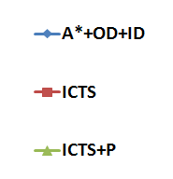
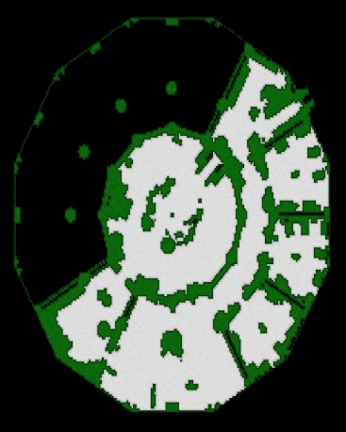
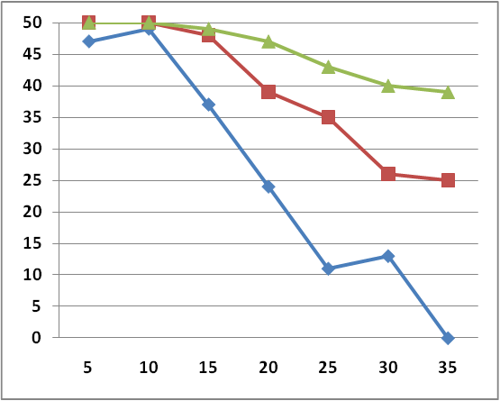
“Dragon Age: Origins” maps
Background
Previous work
ICTS formalization
Theoretical analysis
Do it faster
Summery
x – number of agents
y – number of problems solved (under 5 minutes)

Slide 28
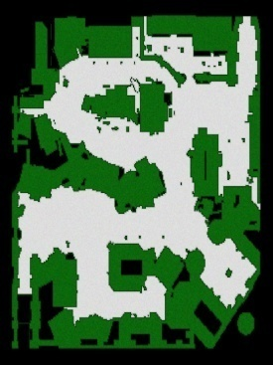
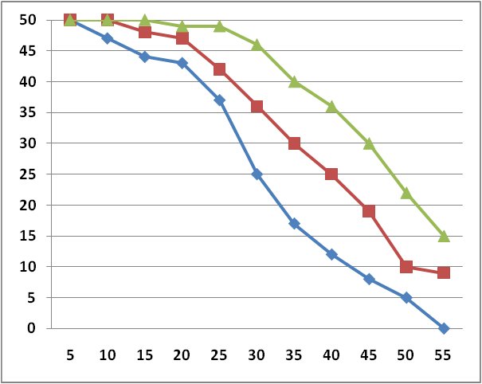
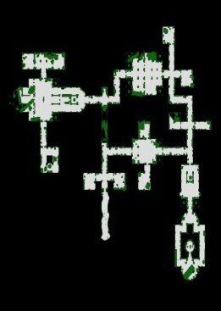
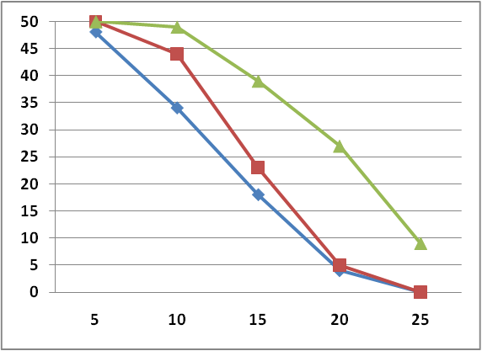

Slide 29
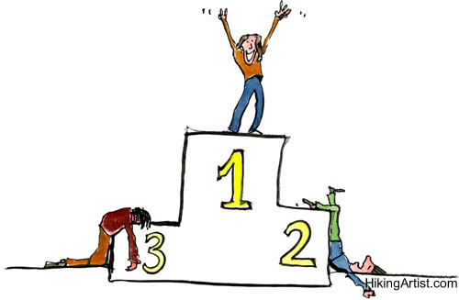
Summary
Background
Previous work
ICTS formalization
Theoretical analysis
Do it faster
Summery
The relative performance between A* and ICTS depends on K and
On many practical cases ICTS outperforms A*+OD+ID.
∆

Slide 30
What next?
Background
Previous work
ICTS formalization
Theoretical analysis
Do it faster
Summery
Better pruning techniques:
  Reuse – remember bad costs sub-combinations
  n-wise pruning [Sharon et al., SoCS 2011]
Anytime/suboptimal version of ICTS
Generalization of the ICTS to other problems
Reducing node generations in the A* approach

Slide 31
The end
Any questions?

