Slide 1
A Cognitive Agent Model
Displaying and Regulating
Different Social Response Patterns
Jan Treur
VU University Amsterdam
Agent Systems Research Group

Slide 2
Introduction
Differences between individuals in social interaction across natural populations
Persons with Autism Spectrum Disorders (ASD) show a wide range of such differences
Occurs much more often in males and in academic, more exact contexts
These differences in social functioning relate to differences in functioning of neural mechanisms
Cognitive agent model based on these neural mechanisms and their variations

Slide 3
Empathic Understanding
Presence of an affective state in a person
Isomorphism of the person’s own and the other person’s affective state
Elicitation of the person’s affective state upon observation or imagination of the other person’s affective state
Knowledge of the person that the other person’s affective state is the of the person’s own affective state source

Slide 4
Social Agent Behaviour
(a) Showing the same emotion as the other agent
Telling that the other agent has this emotion

Slide 5
Elements in the Cognitive Agent Model
Varying extents of sensory processing sensitivity, (e.g., for face expressions of others), and compensatory regulation for this sensitivity
Varying extents of activation of mirror neurons
Varying extents of self-other distinction and control, using super mirror neurons
Varying extents of emotion integration, using as-if (emotion response – feeling) body loops

Slide 6
Overview of the Cognitive Agent Model
sensitivity regulation
self-other distinction
emotion
integration
gaze adaptation loop
WS(g(s))
PS(sens, s, b)
ES(g(s))
WS(B)
SS(B)
SR(B)
PS(B, s, b)
mirroring
WS(s)
SS(s)
SR(s)
PC(B, b)
EC(B, b)
WS(b)
SS(b)
SR(b)
PB(b)
ES(b)
as-if body loop
body loop

Slide 7
Overview of the Cognitive Agent Model
sensitivity regulation
gaze adaptation loop
WS(g(s))
PS(sens, s, b)
ES(g(s))
WS(B)
SS(B)
SR(B)
PS(B, s, b)
WS(s)
SS(s)
SR(s)
PC(B, b)
EC(B, b)
WS(b)
SS(b)
SR(b)
PB(b)
ES(b)
as-if body loop
body loop

Slide 8
Example Model Specification
LP4 Preparing for or mirroring a body state
If the sensory representation of s has level V₁
and the sensory representation of b has level V₂
and the preparation for body state b has level V₃
then after duration Δt the preparation state for body state b will have level V₃ + γ [f(ω₅V₁, ω₆V₂) - V₃] Δt
f combination function
γ update speed factor
ω₅, ω₆ connection strengths
SR(s,V₁) & SR(b,V₂) & PB(b, V₃)
-->> PB(b, V₃ + γ [f(ω₅V₁, ω₆V₂) - V₃] Δt)

Slide 9
Full Empathic Response:
Example Simulation

Slide 10
ASD Characteristics Covered
Regulation of enhanced sensory processing sensitivity, e.g., for face expressions
Reduced activation of mirror neurons
Reduced activation of super mirror neurons for self-other distinctions and control
Reduced emotion integration

Slide 11
Different Types of Responses
 | 1 | 2 | 3 | 4 | 5 | 6 | 7 | 8
feeling body | + | + | + | + | - | - | - | -
expressing body | + | + | - | - | + | + | - | -
communicating | + | - | + | - | + | - | + | -
example conditions | none of ω_{k} low | ω_{7B}, ω_{8B} low or ω₁₁, ω₁₂ low | ω_{7self}, ω_{8self} low | ω₆ , ω₁₁ low |  |  |  | ω₅ low
 | full response | reduced self-other distinction | reduced expression control | reduced emotion integration |  |  |  | reduced mirroring

Slide 12
Reduced Emotion Integration

Slide 13

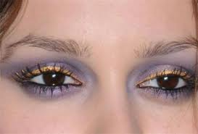
Enhanced Sensitivity of
Sensory Processing

Slide 14
Enhanced Sensitivity of Sensory Processing : Example Simulation

Slide 15
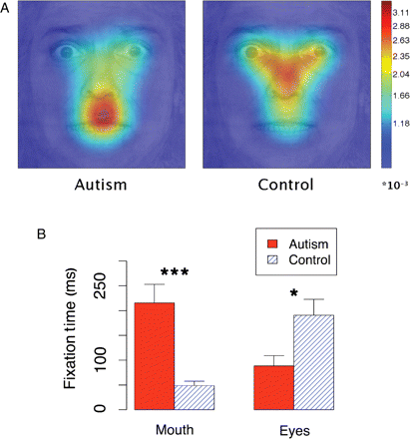
Enhanced Sensitivity of Sensory Processing : Empirical Results
Neumann, D., Spezio, M.L., Piven, J., and Adolphs, R.,
Looking you in the mouth: abnormal gaze in autism resulting from impaired top-down modulation of visual attention.
Social Cognitive and Affective Neuroscience 1 (2006) 194-202
(Fig. 4, p. 198; bubbled faces)

Slide 16
Conclusion
The presented model is able to display social responses in a realistic human-like manner
Covers also of less perfect humans with some ASD-related characteristics
Whether or not users will prefer virtual agents that also display realistic non-ideal social interaction is an open question
Further work underway to compare the computational model to empirical gaze data

