Slide 1
Line Orthogonality in Adjacency Eigenspace with Application to Community Partition
Leting Wu, Xiaowei Ying, Xintao Wu and Zhi-Hua Zhou

Slide 2

Adjacency Eigenspace
  : : A graph with n nodes and m edges that is undirected, un-weighted, unsigned, and without considering link/node attribute information;
  Adjacency Matrix A (symmetric)
  Adjacency Eigenspace
  Spectral coordinate
Notes:
A graph with n nodes and m edges can have various structures. An edge can be directed or undirected. For example, the friendship is usually mutual, while the links between web pages usually directions. In some scenarios, there is weight associated to each link, higher weight means more communication. The edges can even have signs, friends have positive edges, and enemies have negative links. In my research, I mainly focus on the undirected, un-weighted, and unsigned graph. This type of graph can be represented by the adjacency matrix. A_ij is equal to 1 if there is an edge between node I and j. The degree of node I is the number of edges connected to node i. Laplacian and normal matrix also commonly used data structure for social network.

Slide 3
Line Orthogonality
Two recent works observed that nodes projected into the adjacency eigenspace exhibit an orthogonal line pattern.
  EigenSpokes pattern [Prakash et al., 2010]:
    Lines neatly align along specific axes --- EigenSpokes are associated with the presence of tightly-knit communities in the very sparse graph
  k-community graph [Ying and Wu, 2009]:
    There exist k quasi-orthogonal lines (not necessarily axes aligned) in the adjacency eigenspace of a graph with k well structured communities

Slide 4
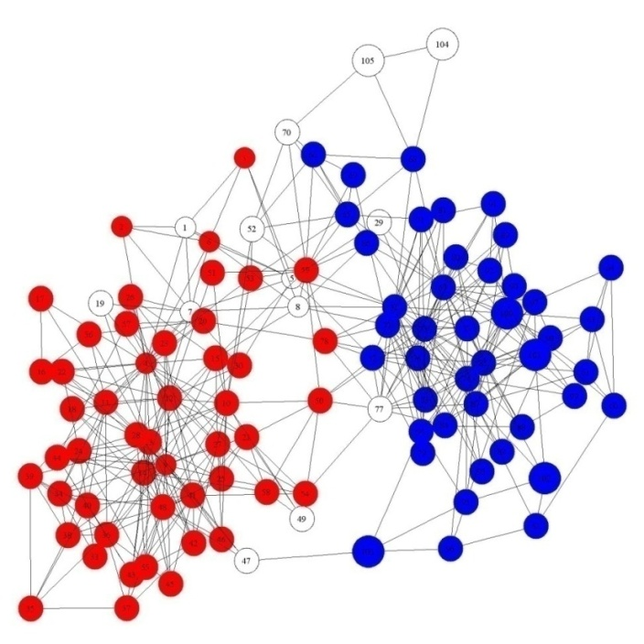
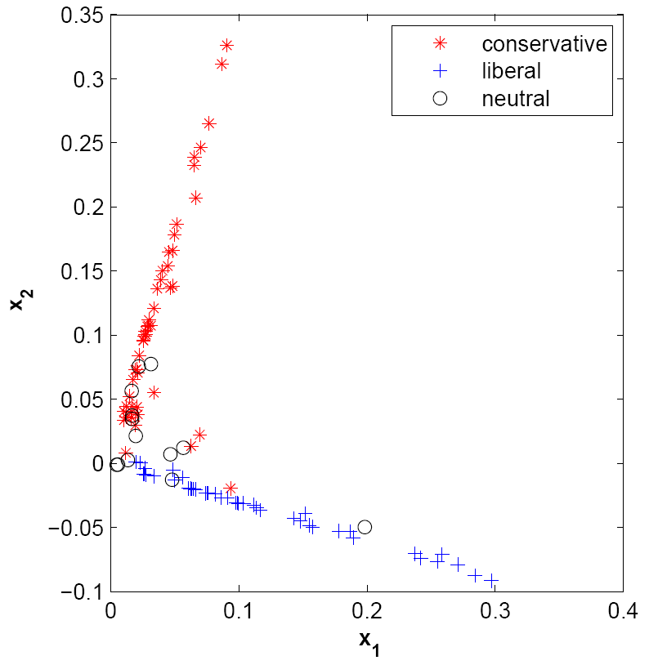
Line Orthogonlity
[Ying and Wu, 2009]
Polbook Network
No theoretical analysis was presented to demonstrate why and when this line orthogonality property holds.

Slide 5
Our Contribution
We conduct theoretical studies based on matrix perturbation theory and demonstrate why the line orthogonality pattern exists in adjacency eigenspace.
We give explicit formula and conditions to quantify
  how much orthogonal lines rotate from the canonical axes;
  how far spectral coordinates of nodes (with direct links to other communities) deviate from the line of their own community.
We show why the line orthogonality pattern in general does not hold in the Laplacian or the normal eigenspace.
We develop an effective graph partition algorithm based on the line orthogonality property.

Slide 6
Outline
Introduction
Spectral Perturbation
Line Orthogonality
Adjacency Eigenspace based Clustering
Evaluation

Slide 7





General Matrix Perturbation Theorem
[Stewart and Sun, 1990]
For perturbed matrix , the eigenvector can be approximated by:
    where
    when the conditions hold:
    The conditions are naturally satisfied if the eigen-gap is greater than .
Involves with all theigenpairs!

Slide 8
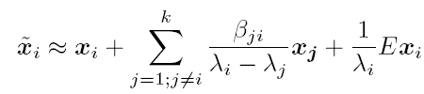

Theorem 1
Based on General Matrix Perturbation Theorem, we simplify its approximation as:
  where
  when the first k eigenvalues are significantly greater than the rest ones.
Involve with only first k eigenpairs!
We will prove the line orthogonality pattern based on this approximation.

Slide 9

Main idea
a k-block diagonal matrix (for k disconnected communities)
a matrix consisting all
cross-community edges
We then examine perturbation effects on the eigenvectors and spectral coordinates in the adjacency eigenspace of .

Slide 10

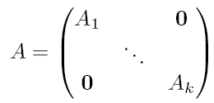
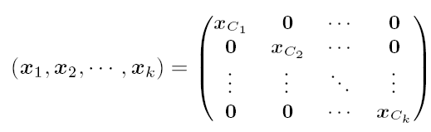


Graph with k Disconnected Communities
For a graph with disconnected communities
, we have:
Adjacency Matrix:
First k eigenvectors:
    where is the first eigenvector of
Spectral Coordinate for node

Slide 11
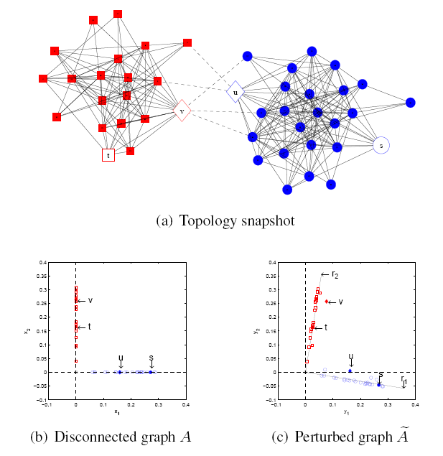
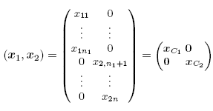
2 Community Example
For disconnected graph :
Two communities lie alone two axes separately

Slide 12



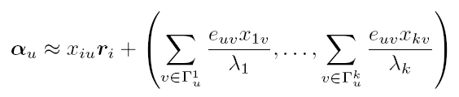
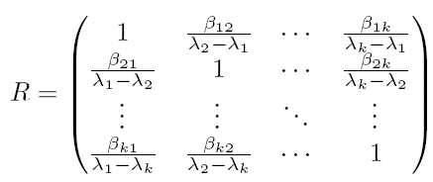
Theorem 2
For graph where is as shown above and denotes the edges across communities. For node ,
denotes the neighbors in for and
where is the i-th row of

Slide 13


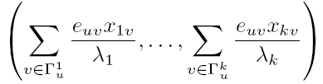

Proposition 2
For , spectral coordinates form k approximately orthogonal lines:
  For node (not directly connected with other communities), and it lies on the line
  For node (directly connected with other communities), deviates from the line with the deviation
  .
Orthogonality is given by when the conditions in Theorem 1 are satisfied.

Slide 14




2 Community Example (Cont’d)
For Observed graph :
Nodes lie alone two orthogonal lines:
,
since
They rotate clockwise from the original axes since

Slide 15
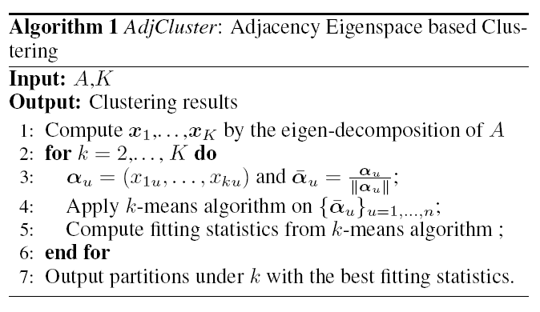
Adjacency Eigenspace based Clustering
Projection onto
k- dimensional unit sphere

Slide 16
Fitting Statistics
Davies-Bouldin Index (DBI )
  low DBI indicates output clusters with low intra-cluster distances and high inter-cluster distances
  We expect to have the minimum DBI after applying k-means in the k-dimensional spectral space for a graph with k communities
Average Angle between Centroids
  We expect the angles between centroids of the output cluster are close to since spectral coordinates form quasi-orthogonal lines

Slide 17

Complexity
No need to calculate all the eigenpairs:
we only need to calculate the first k eigen-pairs and
Sparsity of data reduces the time complexity:
Lanczos algorithm [Goluband Van Loan, 1996] generally needs rather than at each iteration

Slide 18
Evaluation
Four real network data
  Political books (105,441)
  Political blogs (1222,16714)
  Enron (148,869)
  Facebook (63392,816886)
Two synthetic networks
  Syn-1 contains 5 communities with 200, 180, 170, 150 and 140 nodes, each generated by power law method with 2.3
  The ratio between inter-community edges and inner-community edges is 0.2
  Syn-2 has the last two communities in Syn-1 merged (the ratio increase to 0.8)

Slide 19
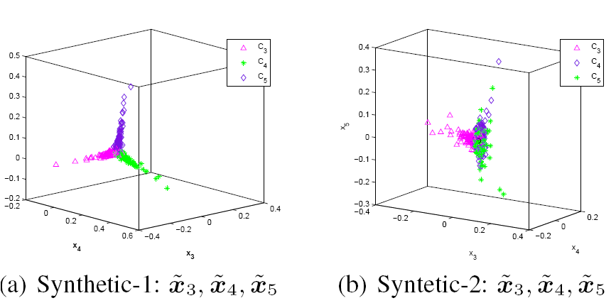
Line Orthogonality Pattern
No line pattern in Syn-2 since C4 and C5 are merged.

Slide 20
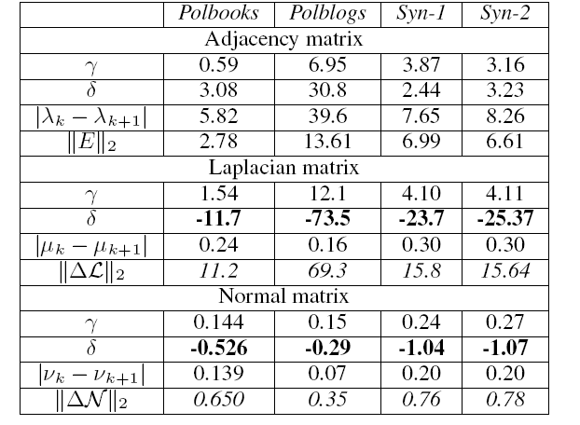


Compare with Laplacian and normal Matrix
The line orthogonality pattern does not hold in Laplacian or normal eigenspace:
c1:
c2:
c3: large eigengap

Slide 21
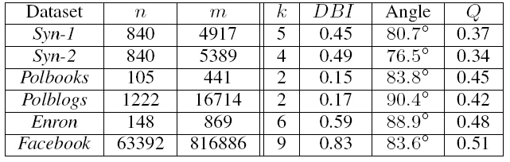
Quality of AdjCluster
k: number of communities
DBI: Davies-Bouldin Index
Angle: the average angle between centroids
Q: the modularity

Slide 22
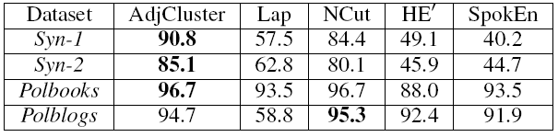


Accuracy Compared with Other Methods
Lap [Miller and Teng 1998]: Laplacian based
Ncut [Shi and Malik, 2000]: Normalized cut
HE’ [Wakita and Tsurumi, 2007]: Modularity based agglomerative clustering
SpokEn [Prakash et al., 2010]: EigenSpoke
Accuracy: where :the i-th community produced by different algorithms

Slide 23
Future Work
Exploit the line orthogonality property for other applications, e.g.,
  Tracking changes in cluster overtime
  Identifying bridge nodes
Compare with other recently developed spectral clustering algorithms
Extend to signed graphs

Slide 24
Thank you! Questions?
This work was supported in part by:
  U.S. NSF (CCF-1047621, CNS-0831204) for L.Wu, X.Ying, X.Wu
  Jiangsu Science Foundation (BK2008018) and NSFC(61073097, 61021062) for Z.-H. Zhou

